Slide 1
REVOU FSDA GFP
Hotel Booking Cancellation
designed by
Adytia Putra Pradana

Slide 2
Our Talented Colleagues
REVOU GROUP FINAL PROJECT
01
02
03
04
Philia Nambarisa
Project Manager
Adytia Putra
Data Visualization
Yolanda Brigitta
Data Analyst
Vega Bramantio
Data Analyst
Responsible for planning, organizing, and directing the completion of group projects while ensuring these projects are on time, and within scope
Visualizing relevant and quality data sources to address problems and recommending strategy through data analysis
Analyzing data and draw conclusions from data to describe, predict, and improve business performance
Analyzing data and draw conclusions from data to describe, predict, and improve business performance
2

Slide 3
Table of Content
REVOU GROUP FINAL PROJECT
01
03
05
Why the experiment is conducted, what are the background of the dataset, quick snapshot of the data
Explain what technique we used to interpret the data, elaborate what has been done to the data
Conclude result from previous data analysis, recommend business decision.
Project Background
Methodology
Recommendation
02
04
Define business problem, what goal should we achieved, root cause analysis
Conduct exploratory data analysis, customer segmentation and prediction model
Scope Definition &
Objectives
Data Exploration
3

Slide 4
Project Background
Hotel Booking Cancellations
REVOU FSDA GFP
Group J

Slide 5
The Problem of Cancellations
PROJECT BACKGROUND
37% Booking Cancelled
Cancellation Policies
Operational Problems
Not Cancelled
Customers are accustomed to free cancellation policies
Uncertainty in booking can cause operational problem such as overstaffing or understaffing
Cancelled
Cancellation Rate
Forecasting
Over the year, the cancellation rate in hotels data was 37%
Cancellation can cause non accurate forecast
Cancellation > non optimized occupancy > poor management > revenue loss
5

Slide 6
Scope Definition & Objectives
Hotel Booking Cancellations
REVOU FSDA GFP
Group J

Slide 7
Scope Definition – Overview of the Data
SCOPE DEFINITION & OBJECTIVES
Hotel Booking Demand Dataset
217K
In this notebook, we are going to analyze the hotel booking dataset provided by kaggle. The data is originally from the article Hotel Booking Demand Datasets, written by Nuno Antonio, Ana Almeida, and Luis Nunes for Data in Brief, February 2019.
This data article describes two datasets with hotel demand data. One of the hotels (H1) is a resort hotel and the other is a city hotel (H2). Both datasets share the same structure, with 31 variables describing the 40,060 observations of H1 and 79,330 observations of H2. The two hotel are both from same Hotel Company in Portugal. Each observation represents a hotel booking.
Both datasets comprehend bookings due to arrive between the 1st of July of 2015 and the 31st of August 2017, including bookings that effectively arrived and bookings that were canceled. Since this is hotel real data, all data elements pertaining hotel or costumer identification were deleted.
Total
Guests
$38M
31
Revenue
37%
Variables
Cancelled
Bookings
July 2015 – August 2017
119K
Total
Bookings
Data Scope
7

Slide 8
Problem Statement & Objectives
SCOPE DEFINITION & OBJECTIVES
The booking cancellation rate was to high at 37% of total bookings made. This have to be reduced.
Exploratory Data Analysis
Customer Segmentation
Cancellation Prediction
What causes high cancellation rate? Can we do something about it?
Is there a way to segment the customer and help reduce cancellation rate?
Can we make model to predict cancellation in the future?
8

Slide 9
Methodology
Hotel Booking Cancellations
REVOU FSDA GFP
Group J

Slide 10
Research Methodology
METHODOLOGY
START
Asking Business Questions
Set the objective of the research and ask correct business questions based on existing problems
Data Acquisition
Collecting data to analyze within scope of the problems. The data collected from data source.
Data Cleaning
Conduct data cleaning from raw data to make the data easier to analyze
10

Slide 11
Data Analysis
Analyzing the data based on the business problem using python
Data Visualization
Using python and tableau to create charts, look for trends, visualize the insight and findings via dashboard
Business Recommendation
Based on the analysis result, give recommendation using best practice in the industry
END
11

Slide 12
Data Cleaning Process
METHODOLOGY
Data Aggregation
Important cleaning method
Dropping Unused Column
Feature format. There is still white spaces that should be removed in few variables;
Removal of Agent and Company variables due to missing data and large categorical characteristics;
Data transformation. Hotel dataset are still missing datetime data so we combine time data to full datetime format. We also adding new feature such as total guests and total day stays by combining existing features.
Data Filtering
Dropping Null Values
Removing Outliers
Transforming the Data
12

Slide 13
Data Exploration
Hotel Booking Cancellations
REVOU FSDA GFP
Group J

Slide 14
Insight
Features with most correlation with booking cancellations are lead time, total of special requests, requested car parking spaces, and previous cancellations.
We found that customer that reserved room type P and making non-refundable deposit have 100% cancellation rate, this is an interesting findings and have to be investigated further.
We were able to identify 4 customer clusters: the cancellation squad, the family, the return customer, and the vacationers.
We identified Random Forest as the model giving us the highest predictive power. This model classifies whether or not a booking will be canceled with 84% accuracy.
Our interpretative Random Forest model revealed that lead time, average daily rate, and deposit payment type are the three features influencing cancellation prediction the most. Our analysis also pointed at the importance of number of special requests and reserved room type.
DATA EXPLORATION
14

Slide 15
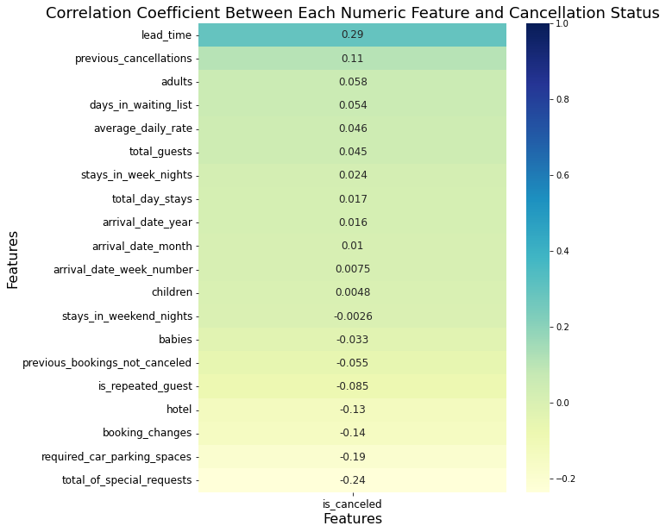
Features Correlated with Cancellation
DATA EXPLORATION
Lead Time
Lead Time means number of days between reservation date and arrival date. More lead time means customers have more time to cancel the reservation.
Special Requests
Engagement with the hotel prior to arrival may make a customer less likely to cancel their reservation. This shows their commitment to the booking.
Requested Parking Spaces
Same with special requests, request of parking spaces shows about customer’s commitment to the booking.
Previous Cancellations
Customer with history of previous cancellations may show us about their tendency to cancel booking.
15

Slide 16
Room Type and Deposit Type Also Have Great Impact on Cancellations
DATA EXPLORATION
Reserved Room Type
Customers who reserved room type P have the highest percentage booking cancellation with 100% of bookings canceled.
Deposit Type
Non-refundable payment policy almost has 100% cancellation rate, the deposit seems to be made more often by transient groups who use a travel agent.
16

Slide 17
Cluster 0 | The Cancellation Squad
DATA EXPLORATION
This cluster have the highest cancellation rate among clusters, and is a group of younger customers trying to plan a vacation in advance. Indeed, September is a very common month for college aged individuals to travel in Europe. Also, they often plan trip in advance (very high average lead time). As a result, cluster 0 will now be referred to as The Cancellation Squad.
Very high cancellation rate (64%)
Plan their trip in advance
(very high avg. lead time)
Most frequent market
Segment : group
Higher mean of prev. cancellation of bookings
17

Slide 18
Cluster 1 | The Vacationers
DATA EXPLORATION
Vacationers book a room with high average daily rate and stays for longer. This cluster also have high cancellation rate because they usually plan their vacation in advance. As a result, cluster 1 will now be referred to as The Vacationers.
Mid cancellation rate
(45%)
Longer day stays
Higher average daily rate
Plan their trip in advance
(high avg. lead time)
18

Slide 19
Cluster 2 | The Return Customer
DATA EXPLORATION
Return Customer may plan their trip last minute since they are already familiar with the destination and hotel and may be less likely to cancel. As a result, cluster 2 will now be referred to as The Return Customer.
Low cancellation rate
(25%)
Plan their trip last minute
(low avg. lead time)
Higher mean of repeated
Guest
Higher mean of prev. booking not cancelled
19

Slide 20
Cluster 3 | The Family
DATA EXPLORATION
Families may be willing to pay more for extra space and comfort in their room. In addition, they may need to make more special requests (such as asking for a crib in the room). Finally, as children do not have school in August and many companies in Europe offer vacation time during that month, it is the most common month for families to travel. As a result, cluster 3 will now be referred to as The Family.
Higher number of children in one booking
Slightly higher average number of special requests
Higher average daily rate
Most frequent arrival month : August
20

Slide 21
Prediction Model Evaluation : Coefficient Interpretation
DATA ANALYSIS & VISUALIZATION
Top 10 Feature Importances
Lead Time are the most important feature used in the model, showing its importance against cancellation. More lead time means customers have more time to cancel the reservation;
Average Daily Rate also have significant feature coefficient. Guests might cancel if they find a comparable room for a better price at a different property or the same room for a cheaper price on a different website;
Deposit Type also important, it’s a matter if we make easier policies and deposit type, customer can easily cancel their bookings.
21

Slide 22
Recommendation
Hotel Booking Cancellations
REVOU FSDA GFP
Group J

Slide 23
Recommendation
We recommend that a deeper understanding of the situation may require additional hotel specific information (such as deposit policies & hotel room information).
Consider offering non-refundable rates. To appeal to more guests, we could offer both non-refundable and flexible rates. Guests who make non-refundable reservations are generally more committed to their stays because they'll have to pay if they cancel, make changes, or no-show.
Manage booking restrictions. We may want to manage booking cancellation policies and restrictions to prevent certain kinds of bookings and lost revenue. Such as tightening the cancellation policies. We flexibility to specify whether we offer free cancellation, what time frame applies, and the charges if guests don’t show up.
Offer compelling prices. As average daily rate is one of the most important features leading to cancellation, guests might cancel if they find a comparable room for a better price at a different property or the same room for a cheaper price on a different website.
23
Notes:
For example, we might want to avoid getting bookings too far in advance, since those guests’ plans are more likely to change and result in cancellations. Setting a “maximum advance reservation” restriction can help prevent this.

Slide 24
Recommendation
Make booking changes and requests easier. More special requests, request of parking spaces, and booking changes means they are less likely to cancel.
Start making strategy for each specific cluster. Those clusters can be used for us to better prepare for our guests, engage with them in a more targeted manner, and give a sense of the cancellation risk.
Consider using our predictive model, as a result, this would allow us to more accurately forecast their occupancy, manage our business accordingly, and increase our revenue.
24

Slide 25
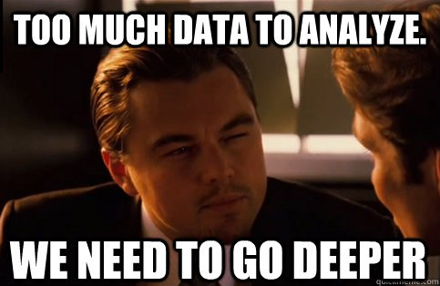
TERIMA KASIH
THANK YOU
Group J

Slide 26
Appendices
REVOU FSDA GFP
Dataset
Visualization & Dashboard
Google Collab – Data cleaning & clustering model
Google Collab – Prediction model
26

Slide 27
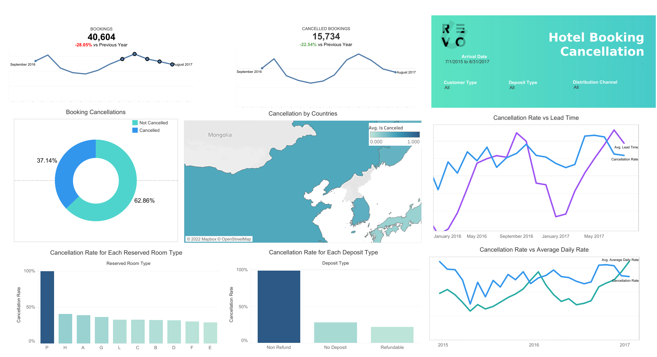
Dashboard
27

Slide 28
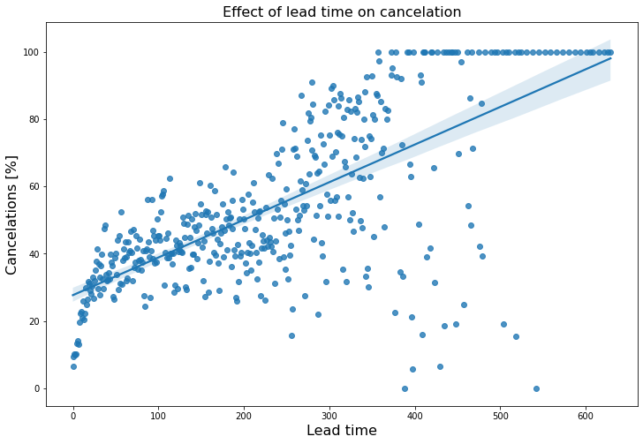
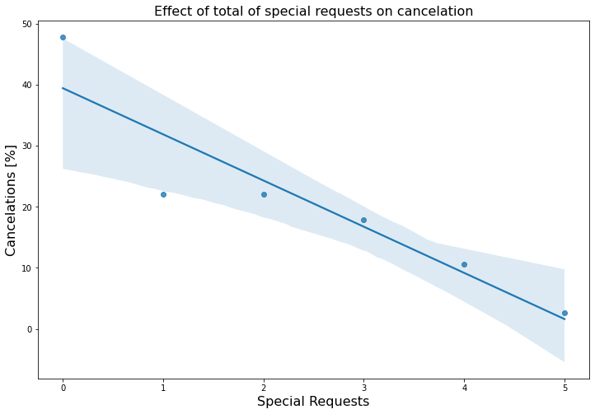
Lead Time and Special Request vs Cancellation
APPENDIX
Lead time have a positive correlation on booking cancellations
Number of special requests have a negative correlation on booking cancellations
28

Slide 29
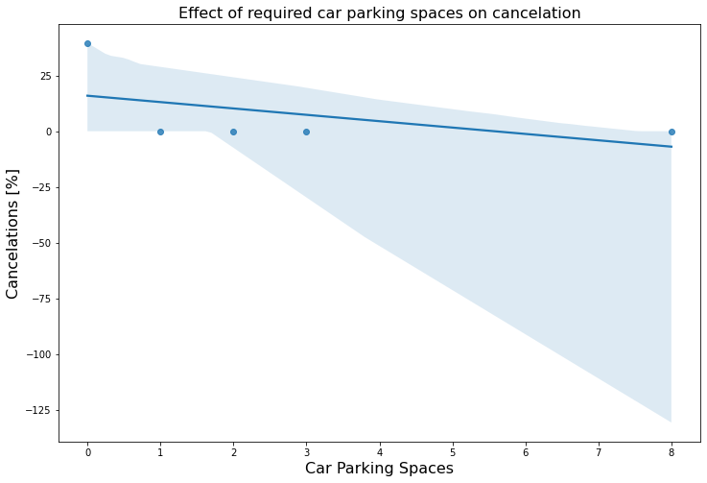
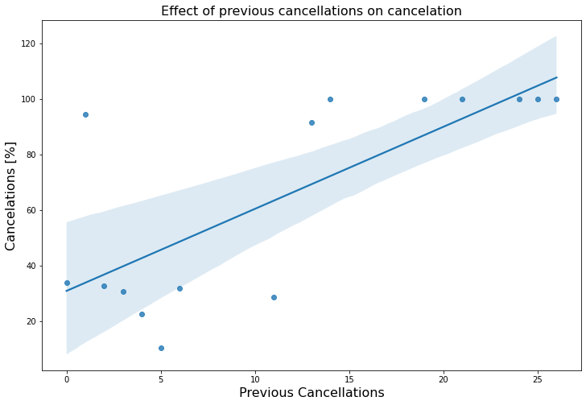
Req. Car Parking Spaces and Prev. Cancellations vs Cancellation
APPENDIX
Required car parking spaces have a negative correlation on booking cancellations
Number of previous cancellations have a positive correlation on booking cancellations
29

Slide 30
Number of Bookings for Each Deposit Type
APPENDIX
30
Notes:
Clustering Method
Drop is cancelled, reservation status to keep the cancellation information (target), since the cluster will be used for our predictive model;
Drop country because it’s a large categorical data, arrival date also dropped because cluster don’t take datetime variable;
We use K-Prototypes since our data is mix between categorical and numerical variable;
Based on the cost, we choose 4 cluster because there is an obvious ‘elbow’ in the elbow method.
Cancellation on Each Cluster
Cluster 0 has the highest cancellation rate (64,43%), hotel management might want to increase priority to decrease their cancellation rate.
Cluster 2 has the lowest cancellation rate (25,11%), hotel management might want to find out why they less likely to cancel.
Overall, all cluster have a respectable amount of cancellation rate.

Slide 31
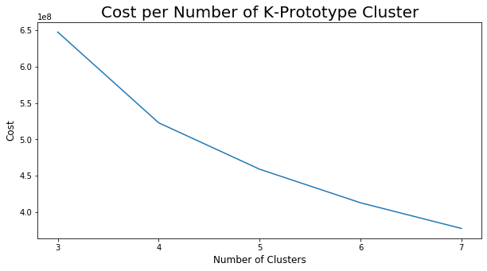
Applying Customer Segmentation to Help Predict Cancellations
APPENDIX
Clustering Method & Explanation
We use K-Prototypes since our data is mix between categorical and numerical variable;
Based on the cost, we choose 4 cluster because there is an obvious ‘elbow’ in the elbow method.
This cluster is also used in our cancellation prediction model, this will be explained later.
31
Notes:
Clustering Method
Drop is cancelled, reservation status to keep the cancellation information (target), since the cluster will be used for our predictive model;
Drop country because it’s a large categorical data, arrival date also dropped because cluster don’t take datetime variable;
We use K-Prototypes since our data is mix between categorical and numerical variable;
Based on the cost, we choose 4 cluster because there is an obvious ‘elbow’ in the elbow method.
Cancellation on Each Cluster
Cluster 0 has the highest cancellation rate (64,43%), hotel management might want to increase priority to decrease their cancellation rate.
Cluster 2 has the lowest cancellation rate (25,11%), hotel management might want to find out why they less likely to cancel.
Overall, all cluster have a respectable amount of cancellation rate.

Slide 32
Customer Cluster and Their Characteristics
APPENDIX
32
Notes:
Clustering Method
Drop is cancelled, reservation status to keep the cancellation information (target), since the cluster will be used for our predictive model;
Drop country because it’s a large categorical data, arrival date also dropped because cluster don’t take datetime variable;
We use K-Prototypes since our data is mix between categorical and numerical variable;
Based on the cost, we choose 4 cluster because there is an obvious ‘elbow’ in the elbow method.
Cancellation on Each Cluster
Cluster 0 has the highest cancellation rate (64,43%), hotel management might want to increase priority to decrease their cancellation rate.
Cluster 2 has the lowest cancellation rate (25,11%), hotel management might want to find out why they less likely to cancel.
Overall, all cluster have a respectable amount of cancellation rate.

Slide 33
Booking Cancellation Prediction Model
APPENDIX
Cancellation Prediction
To determine a supervised learning model to predict booking cancellation based on available variables. We use several training model to give best prediction accuracy score. Cluster feature also included in model used.
Model Used
Features
Baseline
Logistic Regression
Decision Tree Classifier
Random Forest Classifier
X = 27 Variables
Y = Cancellation Rate
We use Random Forest for our prediction model not only because it has highest predictive power, it also adds additional randomness to the model (not overfitting), while growing the trees. This results in a wide diversity that generally results in a better model.
33

Slide 34
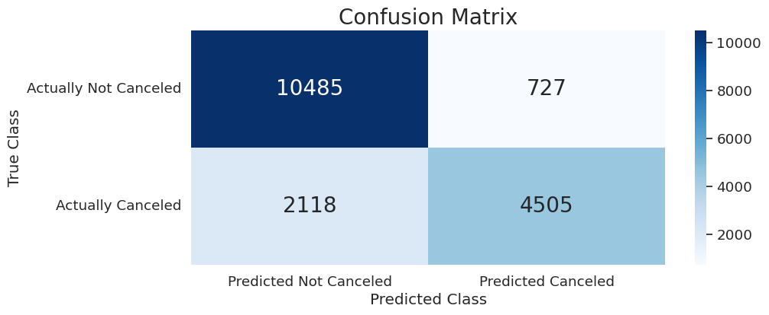
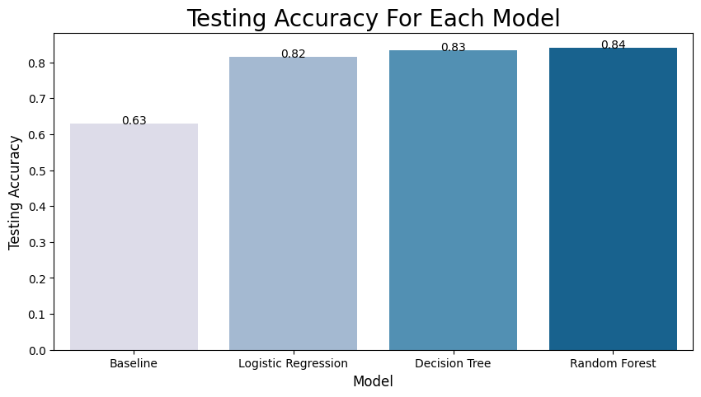
Booking Cancellation Prediction Model
APPENDIX
Model Selection
Confusion Matrix
Model Used
Correctly classifying:
68% of cancelled bookings
94% of not cancelled bookings
86% predicted cancelled actually canceled
83% predicted not cancelled actually not canceled
Management:
4% of cases: hotel may not be ready for guest, risk of overbooking
12% of cases: hotel allocating their resources on the wrong reservations
We use Random Forest for our prediction model because it adds additional randomness to the model (not overfitting), while growing the trees. This results in a wide diversity that generally results in a better model.
34

